Slide 1
AR & VR Industry
Baskoro Nugroho (930436)

Slide 2
AR vs VR
VR: Replaces Reality, taking you somewhere else
AR: Adds to reality, projecting information on top of what you’re already seeing

Slide 3
Industry Applications and Use Cases
Healthcare
VR to operate patients remotely
Collaborative surgeons
Retail and Marketing
Amazon
Business and Education
Meeting
Recruitment
Arts and Entertainment
Attend events without leaving home (allowing more people to attend the event that currently possible)
Gaming
PlayStation VR
PlayStation Games with VR
Construction
3D building Modeling
Military
Combat simulations
Train Soldies
Travel and Tourism
Virtual Tours Remotely
Google Translate
Automotive
Head-up displays (HUDs)
BMW motorcycle visor concept
Industrial and Manufacturing
Inventory
Fashion
MakeUp Genius
sephora, nike
Music
On stage with the band during virtual performance

Slide 4

Current State of the Industry
Google, Apple, Amazon, Microsoft, Sony, Samsung, and Intel all have internal groups devoted to AR and VR work
Google Glass (early-stage prototype didn’t take off as expected)
PokemonGo (succesfully hit worldwide adoption in record time)
Developer Toolkit (Apple’s ARKit) -> continue developed and expanded
AR Headsets (Micosfot HoloLens) -> continue developed and expanded
Facebook purchased Oculus for $2B in 2014
from pet project continued into serious focus.
Magic Leap has raised $2.4B to date, with 21,8% of it comes from Google
Image: https://www.eurogamer.net/articles/2019-12-19-pokemon-go-buddy-adventure-play-excited-6002

Slide 5
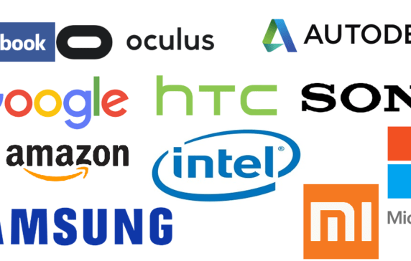
Key Players In the VR/AR Game
Facebook/Oculus (Rift, Go, and Quest)
HTC and Valve Corporation (HTC Vive Pro)
Google (Daydream and Cardboard)
Apple (ARKit)
Microsoft (HoloLens)
Magic Leap (Magic Leap One)
Samsung (Gear VR)
Huawei
Intel
PlayStation (PlayStation VR), already has over 500 games
Mira (Mira Prism)
Meta (Meta 2 AR Development Kit)
image: https://www.cbinsights.com/research/ar-vr-corporate-activity/

Slide 6
Market Statistics
88% of mid-market companies were using (VR/AR) in their business
In 2018, USA consumers are accessing VR/AR technologies on devices (smartphone 77%, PC/Console 35%, standalaone 35%)
Device Shipments, predicted to reach 5 million by the end of 2019

Slide 7
Predicted VR industry revenues, in millions. (Data courtesy SuperData Research.)

Slide 8
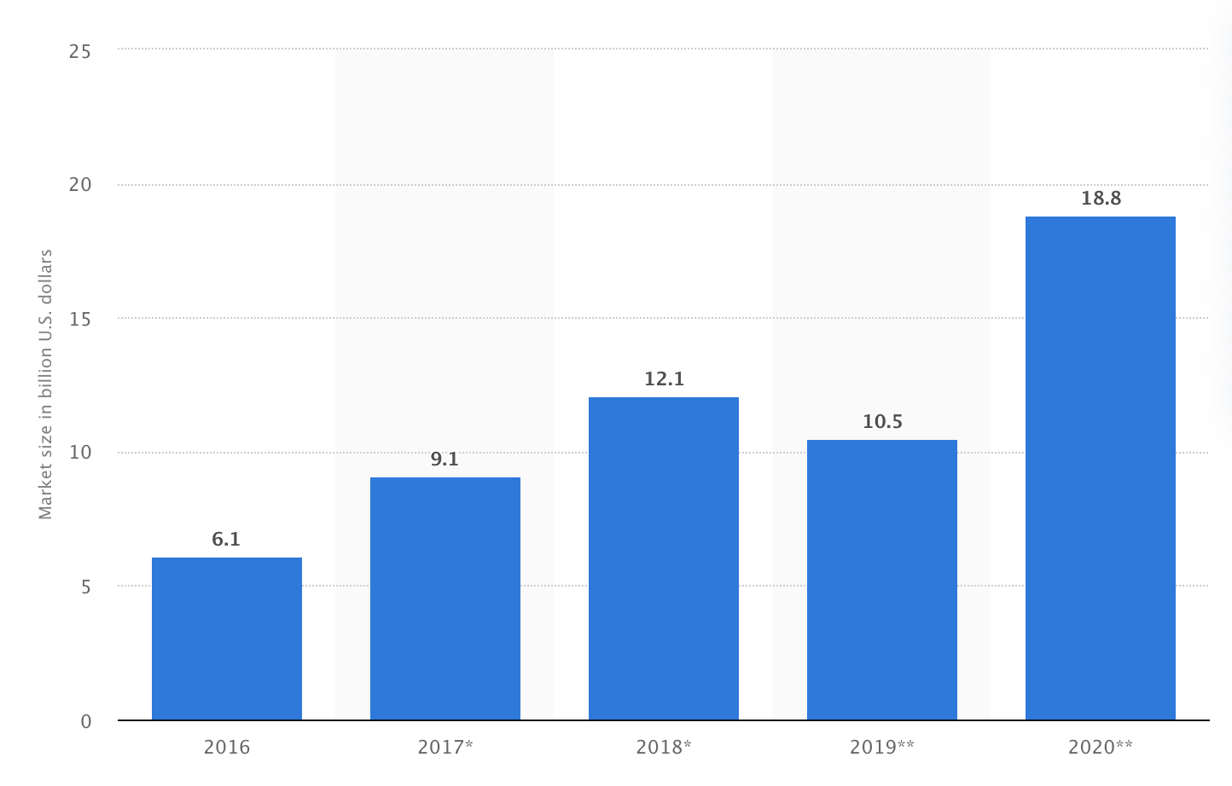
Projected Size of the (AR/VR) Market
*Consumer spending made up the single largest portion of the AR/VR market worldwide
chart: https://www.statista.com/statistics/591181/global-augmented-virtual-reality-market-size/

Slide 9
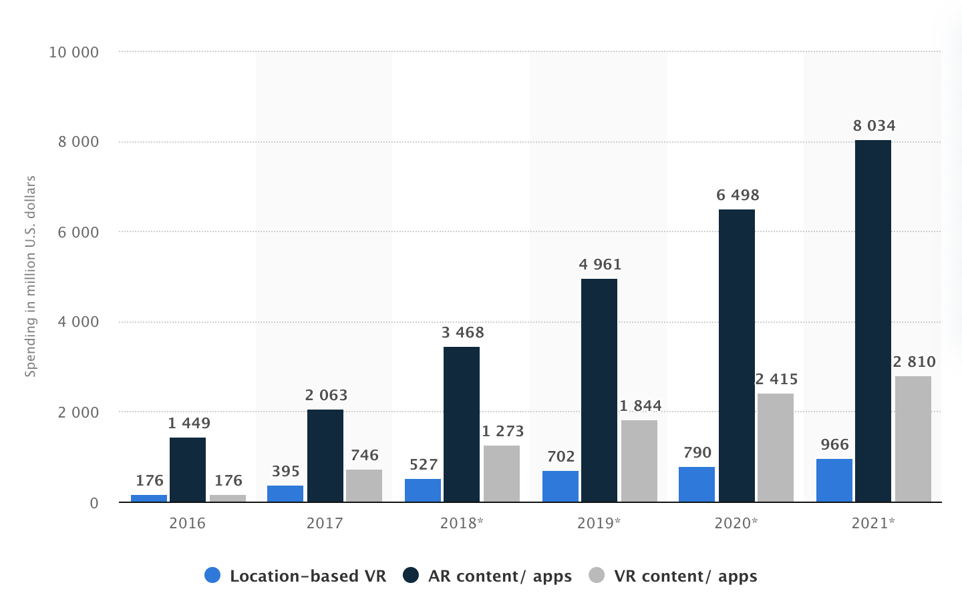
Consumer spending on (AR/VR) content and apps worldwide from 2016 to 2021
chart: https://www.statista.com/statistics/828467/world-ar-vr-consumer-spending-content-apps/

Slide 10
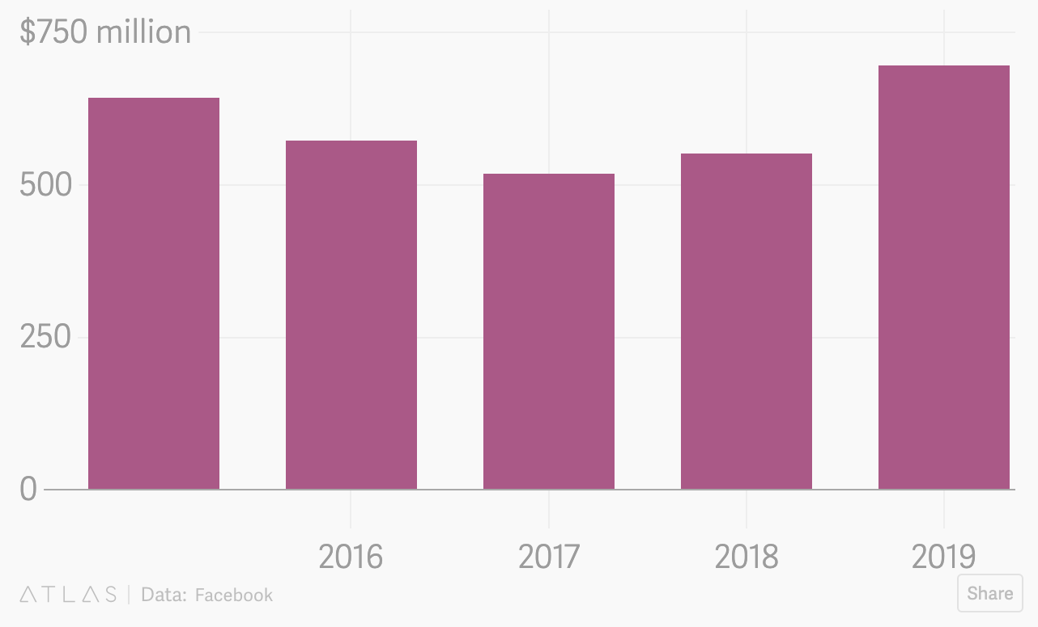
Financial Review: FB non-advertising Revenue
Source: https://theatlas.com/charts/xlZ8_JYdO

